Slide 1





Functional Testing with ASP.NET MVC Jimmy Bogard - @jbogard jimmybogard.lostechies.com Headspring

Slide 2
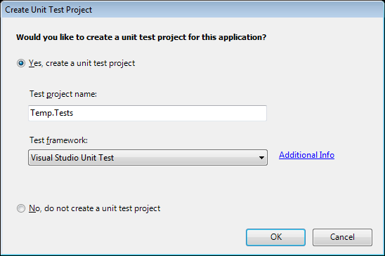
Notes:
Testing story so far
Testing has been part of MVC from the beginning.
Exciting part of Scott Guthrie’s first demo of MVC at Alt.Net 2007 was the inclusion, right at the start, of a testing project.
Don’t need the MVC runtime to be running:
Construct a controller, call its action method, make assertions about the ViewData coming back, all within a unit test. [next slide]

Slide 3
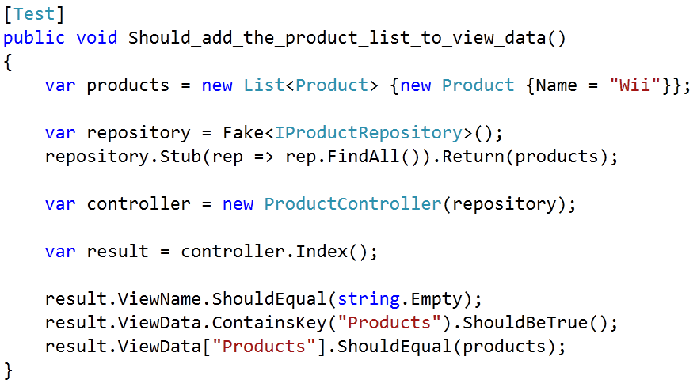
Notes:
Typical unit test

Slide 4
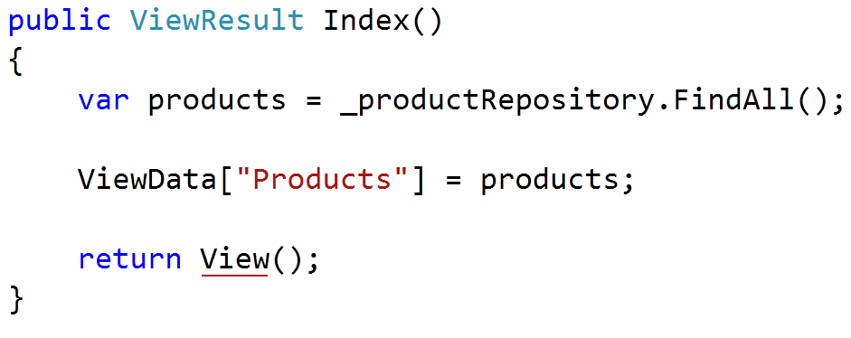
Notes:
Make it pass
But is a passing unit test enough? [next slide]

Slide 5
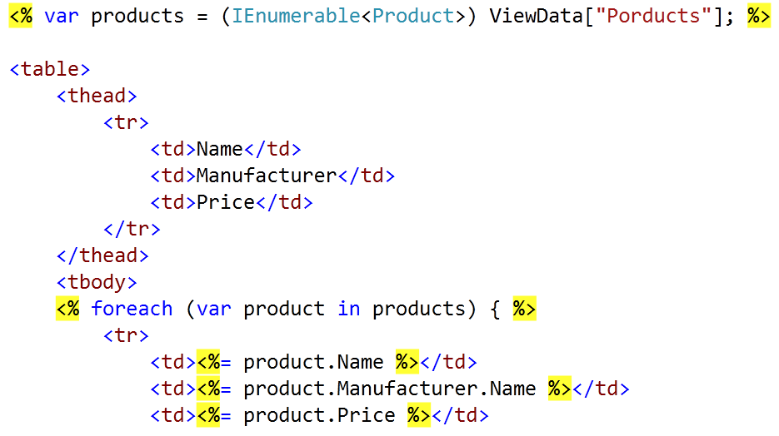
Notes:
Innocent mistake

Slide 6
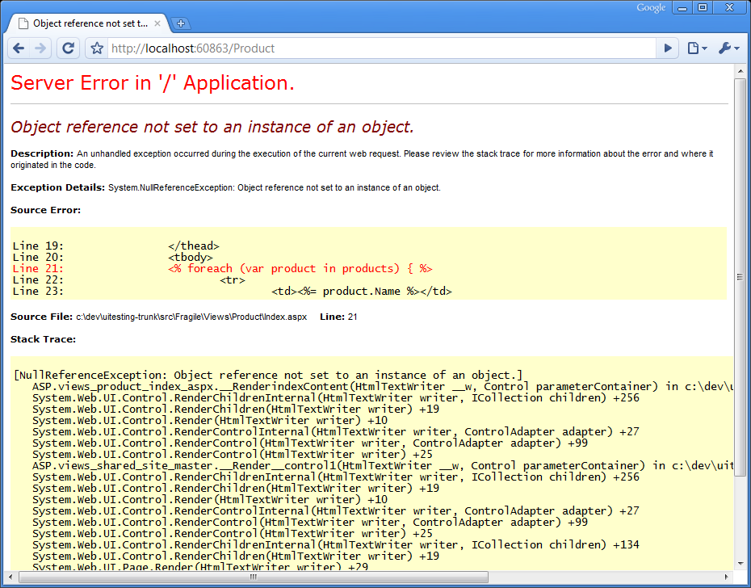
Notes:
Blammo!
Other players before your data get onto the screen, too:
Filters, Actions… Does the view even exist?
[Therefore… next slide]
Unit tests good, but not complete
Our tests can pass, but our site can be broken
We need confidence to change the UI layer
Without an expensive, time-consuming QA cycle,
where making a change restarts the cycle.

Slide 7




Notes:
An IE driver, which you call from your tests via C#.
Test-runner platform that works with many test frameworks.
When it runs the WatiN tests as part of our CI build, it captures screenshots when there’s a failure.

Slide 8
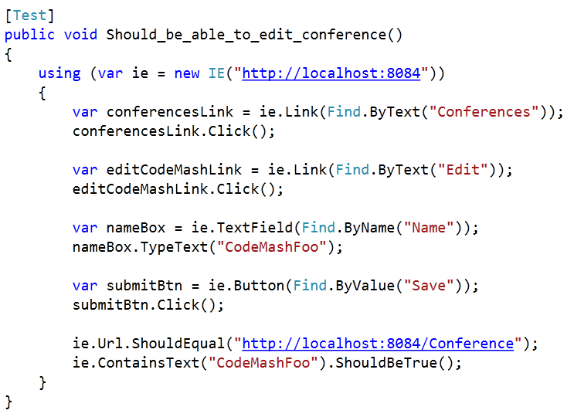
Notes:
Our first try…
I don’t understand what this is doing
What could cause this test to break?

Slide 9
Conferences link text could change
Edit link text could change
Could pick wrong conference to edit
Input element name could change
Save button text could change
Could have more than one form on page
Landing url could change
Conference name text could be anywhere
Notes:
Count the ways this could break
On #4, finding the textbox by name throws away the refactor-friendly advantage from using EditorFor(x => x.Name).
On #7, asserting the destination url flouts our work on the routing engine. Also, the assertion doesn’t semantically fit what we’re trying to test.
If we want value from these tests, it has to get a lot better

Slide 10
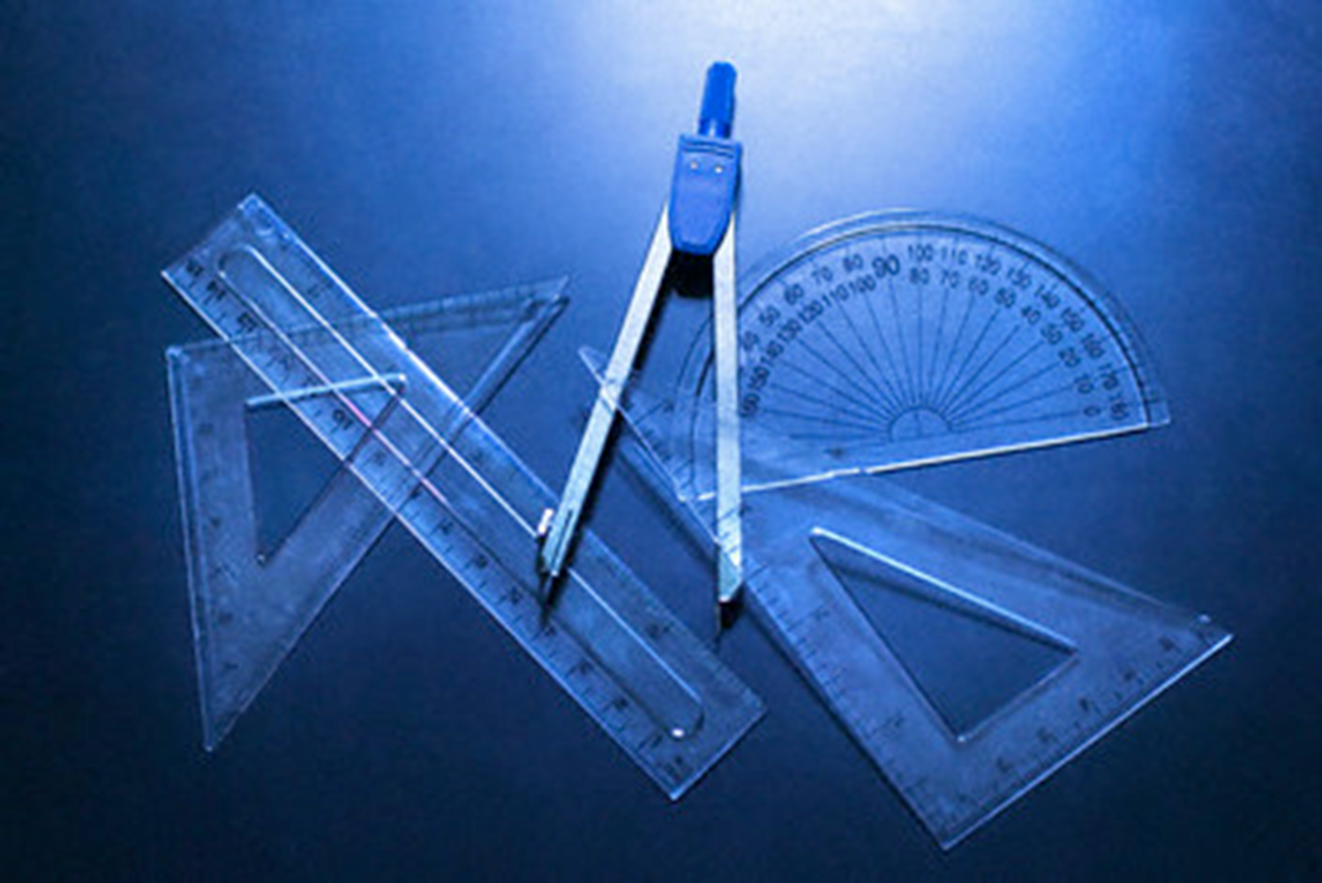
Notes:
Solution
Design for Testability + MVCContrib
Design views with testing in mind.
Just as we design our domain classes to be more testable, likewise our views.
MVCContrib provides helpers.

